Slide 1

Activities and Discussions CSG2344
Project Methods and Professionalism
Human Resource Management
For discussion and thought
ECU Copyright 2014 – CSG 2344 School of Computer and Security Science

Slide 2

Activity objectives
Scenario:
You are the PM for quite a large project to produce a new product website linked to a database
ECU Copyright 2014 – CSG 2344 School of Computer and Security Science

Slide 3

Which staff should do what?
You have been allocated a team of staff who have all come from completed projects
ECU Copyright 2014 – CSG 2344 School of Computer and Security Science
Notes:
like biological life cycle
start as a gleam in someones eye…
birth
development
useful life
loss of fitness for purpose ---surgery
death

Slide 4

What to Schedule?
Your first task
is to identify all the roles/jobs required for the project.
ECU Copyright 2014 – CSG 2344 School of Computer and Security Science
Notes:
like biological life cycle
start as a gleam in someones eye…
birth
development
useful life
loss of fitness for purpose ---surgery
death

Slide 5

It depends on…?
Next:
Everyone must write a very short CV
(less than half a page) listing all their relevant skills
ECU Copyright 2014 – CSG 2344 School of Computer and Security Science

Slide 6
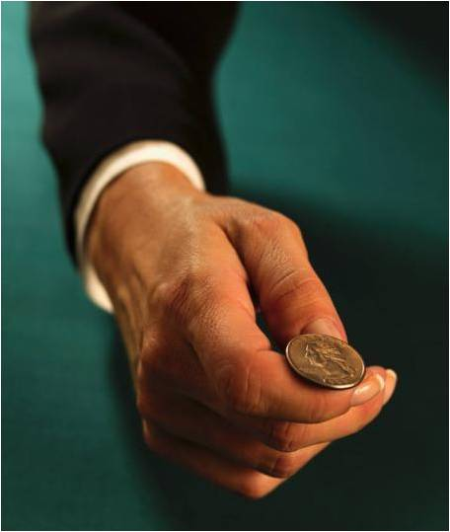
Who is in charge?
Now you must decide
who should be
the project manager.
ECU Copyright 2014 – CSG 2344 School of Computer and Security Science

Slide 7

Who is in charge?
The project manager must now allocate all the identified tasks to appropriate people
based on their CVs.
(They can seek advice from the rest of the team.)
ECU Copyright 2014 – CSG 2344 School of Computer and Security Science

Slide 8
Allocations
Prepare a list
of all the jobs
and who is allocated to each,
with a short justification for each choice.
ECU Copyright 2014 – CSG 2344 School of Computer and Security Science

Slide 9
Skills and Allocations
What skills
did you need
to be successful
for that project?
ECU Copyright 2014 – CSG 2344 School of Computer and Security Science

Slide 10

Skills and Allocations
What would
have made the task easier?
ECU Copyright 2014 – CSG 2344 School of Computer and Security Science

Slide 11

Skills and Attributes
What attributes are important
for a good project team?
ECU Copyright 2014 – CSG 2344 School of Computer and Security Science

Slide 12
Motivation
What would motivate a team?
ECU Copyright 2014 – CSG 2344 School of Computer and Security Science

